Slide 1
Healthy, sustainable diets: making the business case

Slide 2
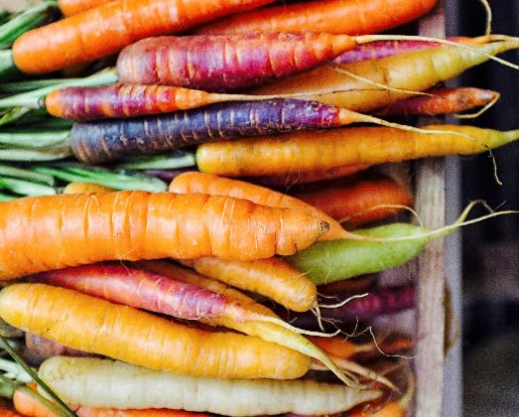
Our diet impacts on our health and the planet
Healthy, sustainable diets: making the business case
Changing what we eat and drink, is the most impactful way to improve our health and that of the planet¹
Obesity is one of the biggest health problems this country faces
2/3 of UK adults are above a healthy weight²
We produce, eat and waste more food than ever
Up to 1/3 of carbon emissions and 70% of freshwater use is for agriculture¹
1. EAT Lancet, 2019, 2. NHS Digital (2020) Statistics on Obesity, Physical Activity and Diet, England, 2020
Notes:
To put this into context,
Around two-thirds of adults in England are overweight, and of these, half are living with obesity
It’ not good for children either – one in five are overweight or obese by the time they start primary school, and this rises to one in three by the time they leave
Excess weight puts people at increased risk of serious and potentially life-threatening conditions like heart disease, type 2 diabetes and some cancers – as well as greater risk of serious illness and death from COVID-19.

Slide 3
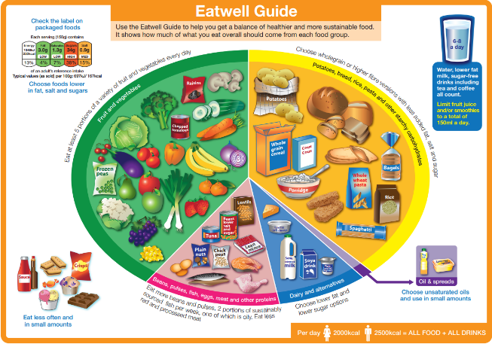
Most people aren’t eating a healthy diet
Healthy, sustainable diets: making the business case
There are several models illustrating a healthy, sustainable diet
UK government guidance The Eatwell Guide¹, sets a good direction of travel, by being better for our health and better for the planet
Currently less than 1% of the UK population meet these targets
Benefits of following The Eatwell Guide
31% GHG emissions
34% Land use
17% Water use
17.9m Years of healthy life
Source: BNF literature review 2020, Eatwell guide, 2015, The Carbon Trust (2016) ‘The Eatwell Guide: Modelling the Health Implications of Incorporating New Sugar and Fibre Guidelines
Notes:
Supporting information:
Evidence shows we need to eat:
More plant-derived foods, like fruit, veg, beans and grains
Less meat and dairy
Less of foods high in fat, sugar and salt
There is substantial scientific evidence that links diets with human health and environmental sustainability (EAT Lancet).
Most studies conclude that a diet rich in plant-based foods and with fewer animal source foods confers both improved health and environmental benefits (EAT Lancet).
The Carbon Trust undertook a carbon footprint assessment comparing current intakes (NDNS) with the (new) Eatwell guide and found that if the population could adopt the Eatwell dietary recommendations, the overall carbon footprint would be reduced by almost a third (32%): 31% reductions in GHGe, 34% reduction in land use and 17% reduction in water use.
It also reported an increase in average life expectancy (5.4 months); and avert 17.9 million DALYs over the lifetime of the current population. A large proportion of the health benefits are from prevention of dietary related diseases including type 2 diabetes, cardiovascular diseases and some cancers.

Slide 4
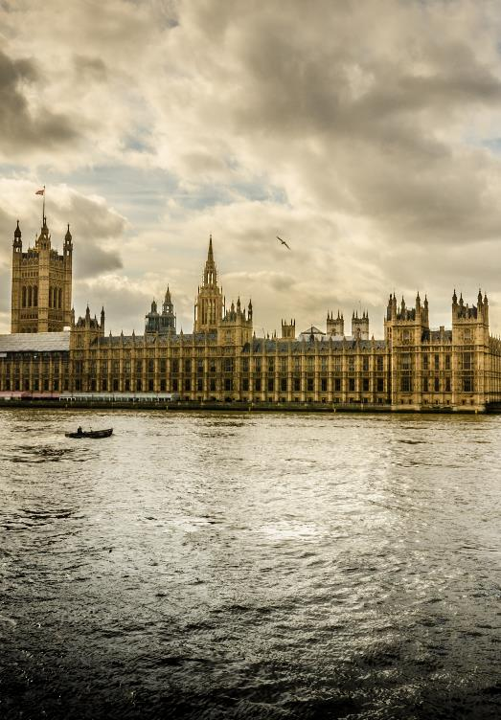
Improving what we eat is a priority for government
Healthy, sustainable diets: making the business case
Healthy, sustainable and affordable food is central to UK government policy
Reformulation targets aim to make food and drink healthier
Restrictions on promoting foods high in fat, salt and sugar will come into force April 2022. A 9pm watershed will also prevent these foods being advertised on TV
A system wide, independent review – The National Food Strategy – is due Summer 2021. Government will respond within 6 months
The Department of Health and Social Care, with Sir Keith Mills, is exploring how incentivisation can promote healthier diets
Notes:
It’s been nearly five years since the government published its Childhood Obesity plan, which committed to halve childhood obesity by 2030. Since then action has broadened to adults and children, spanning multiple initiatives.
Reformulation targets aim to make food and drink healthier
Restrictions on promoting foods high in fat, salt and sugar will come into force April 2022. A 9pm watershed will also prevent these foods being advertised on TV
A system wide, independent review – The National Food Strategy – is due Summer 2021. Government will respond within 6 months
The Department of Health and Social Care, with Sir Keith Mills, is exploring how incentivisation can promote healthier diets

Slide 5
Increasingly shoppers want help to eat healthily and sustainably
Healthy, sustainable diets: making the business case
57%
36%
51%
of consumers have an appetite for healthy, sustainable diets
of British shoppers claim to be following or are interested in following a flexitarian diet
ate fruit and veg more often during lockdown highlighting an opportunity to continue healthy habits
Source: IGD ShopperVista, 15th-16th Sep’20. Base: 2,005 GB grocery shoppers
1. IGD Appetite for Change 2020, 2. IGD ShopperVista, 15th-16th Sep’20. Base: 2,005 GB grocery shoppers 3. IGD Appetite for Change, Fruit and Vegetable deep dive - 2020
Notes:
Supporting information:
33% of consumers say they’re already following healthy, sustainable diets
24% are considering it
---
36% of British shoppers claim to be following or are interested in following a flexitarian diet 48% of 18-24 year olds say the same
---

Slide 6
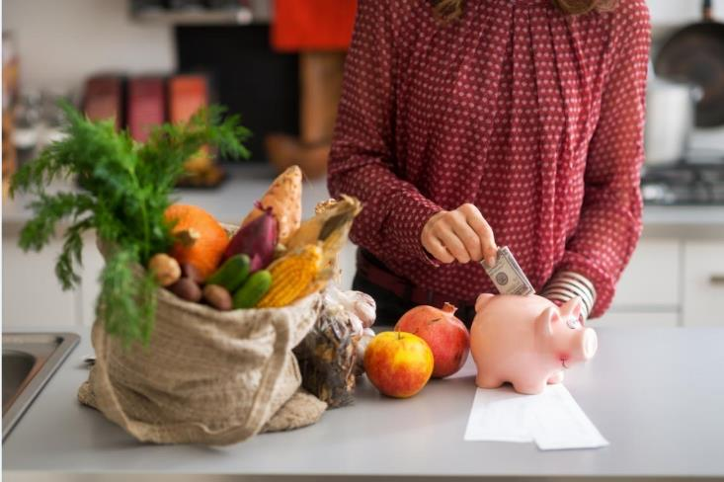
Cost is a barrier to changing diets
Healthy, sustainable diets: making the business case
71% of shoppers believe eating healthily is more expensive than eating unhealthily¹
38% say cost stops them eating a healthy, sustainable diet²
Co-op has recently reduced the price of plant-based meat alternatives, to match the price of meat, and tackle the cost barrier³
1. IGD ShopperVista, March 2021 Base: 2,090 British adults. 2. IGD Appetite for Change COVID-19 update (Base: Total Sample, 1002 (Nov’19) 3. Co-op, May 2021
Notes:
Supporting information:
The pandemic has left many feeling worse off financially and our previous chapter of Appetite for Change found that perceived higher cost remains the top barrier to healthy and sustainable eating in the wake of COVID-19.
IGDs latest research reinforces this. When we asked people to imagine their budget for food and groceries was significantly reduced, 21% told us they would find it easy to give up buying healthy foods and 1 in 10 (11%) would find it easy to give up buying fruit and vegetables.
More than ever affordability is key in helping sustain positive behaviour

Slide 7
There is an opportunity for businesses to make healthy sustainable diets easier and more affordable for all
Healthy, sustainable diets: making the business case

Slide 8
Promoting health can drive sales and loyalty
Healthy, sustainable diets: making the business case
Need proof?
57% of consumers want to follow healthy, sustainable diets¹
Sales of meat-free products increased 40% between 2014 and 2019²
Sainsbury’s inspired a 387% rise in sales of fruit by partnering with Disney³
Tesco found two-thirds of shoppers purchased more fruit and veg when offered free fruit in store⁴
Pret-A-Manger show that plant-based is ‘not just for veggies’ as 80% of their products are vegetarian or vegan⁵
There’s an opportunity to drive sales and improve brand reputation.
Taking action on health and sustainability builds trust with shoppers and wider stakeholders.
Source: 1. IGD, 2020. Appetite for Change – Covid 19 Update 2. Mintel UK Meat-Free Foods Market Report 2019 3. Sainsbury’s uses pester power for good; 4. Tesco increases shopper loyalty; 5. Pret 2019 ESG report, 2020

Slide 9
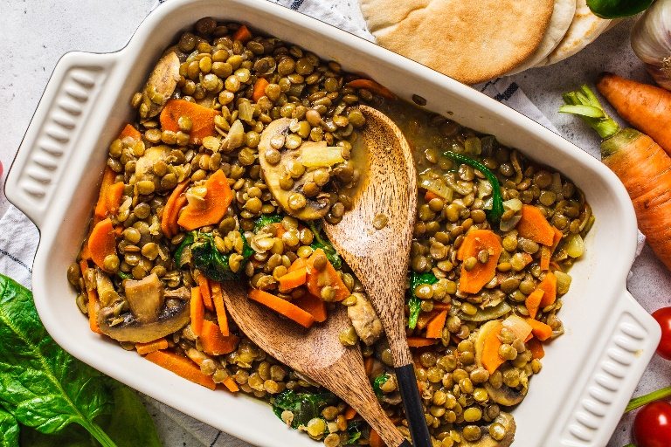
Many businesses are already taking action
Healthy, sustainable diets: making the business case
In 2020 school, hospital, university and care home caterers across the UK pledged to cut meat by 20%
Tesco will boost sales of meat alternatives 300%, by 2025
Asda has committed to growing plant-based sales by 100% by 2023
Mindful Chef became the UK’s bestselling recipe box by championing health and sustainability
There are many more working to make their products and supply chains better for the planet.
Let's work together to drive tangible change and make healthy, sustainable diets easier for everyone.
Source: Tesco

Slide 10
IGD is helping industry drive change
Healthy, sustainable diets: making the business case
86% of shoppers are trying to improve their health in some way, but they want help.
That’s why IGD is working with the University of Leeds and industry, to test behaviour change levers in real-life settings.
We’re measuring how pricing, promotions, and placement can impact shoppers’ baskets and their eating habits.
Get in touch to get involved: healthyeating@igd.com
IGD Shopper Vista, March 2021

Slide 11
How you can take action
Healthy, sustainable diets: making the business case
Visit our new online hub
It’s packed with resources to help you:
understand why healthy, sustainable diets should be central to your business strategy
get inspiration from what other organisations are doing
learn about our real-life trials and research partners
Contact us
Ask us any questions you have
Tell us about your success stories
Work with us to trial real-life solutions and inspire others
Take me to the hub
Get in touch

